Slide 1
Analysis of causes of deaths among children under 15 years in seven provinces of Zambia- 2020 to 2021
Mulenga Chilufya S,A
Zambia Field Epidemiology Training Program

Slide 2
Presentation outline
Background
Objectives
Methods
Results
Discussion
Limitation
Conclusion & recommendations

Slide 3
Background
In 2018 about one fifth of all the certified deaths occurred amongst children under 15 years
Under-five mortality rate 9 times higher WHO AFRO at 74/1000 live births vs the WHO European Region at 8/1000 live births
Child mortality rates varies among Africa countries
The child mortality rate in Zambia has declined over the past few decades (176.5 deaths per 1,000 live births in 1971 to 61.4 deaths per 1,000 live births in 2020)

Slide 4
Background
In Ethiopia-children aged <15 yrs were 16 times more likely to die from communicable, perinatal and nutritional conditions
At UTH (Zambia)-top 10 cause of death (COD) among BIDs in children aged 1/12- 13 years were: pneumonia, diarrhoea, HIV/AIDS, malaria, fires, drowning, CVDs, meningitis, other defined COD, and road traffic accident

Slide 5
Background
In Zambia 47% of the deaths occur outside HF
Mortality surveillance using VA provides important information about CODs among BIDs
assess programmatic needs, prioritize interventions and monitor progress of the interventions

Slide 6
Objectives
To determine the top five CODs among BIDs in children below 15 years, in Zambia from 2020 to 2021
To determine the proportion of BID children and the predictors of the leading COD.

Slide 7
Method
A cross sectional study using data from VA collected in Zambia from 2020-2021
BID –any community death or with ≤48 hrs of arrival at HF.
WHO tool was used to collect data.
COD is assigned by a validated computer algorithm (InterVA5).

Slide 8
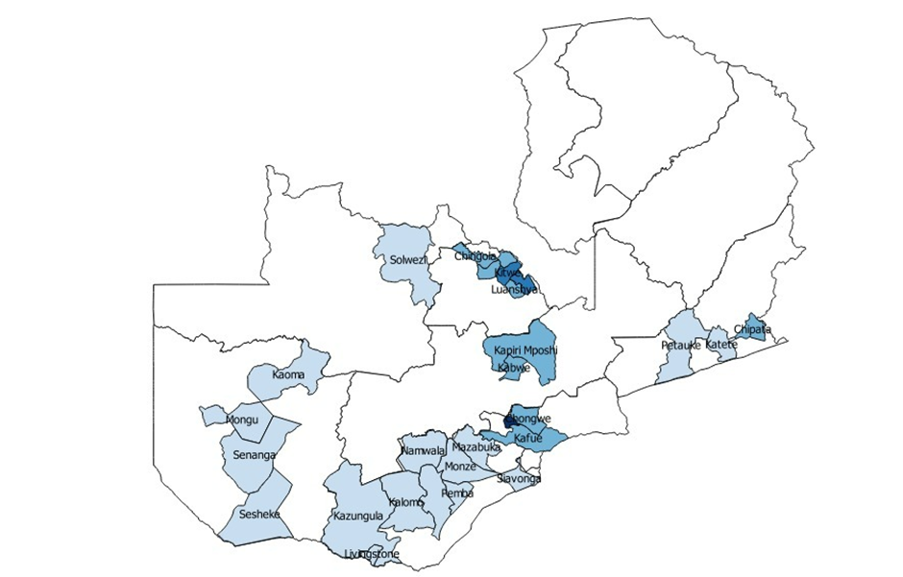
Method
Study sites:
27 districts in seven provinces (Western, Central, Lusaka, Eastern, Southern, North-western and Copperbelt)
Study population
BID children <15 yrs captured using VA between 2020 and 2021
Sample size and selection
All <15 yrs children BID from 2020 to 2021
Outcome variable; COD
Figure 1; District that conduct VA in Zambia

Slide 9
Method
Top five CODs were determined by running frequencies and percentages.
Multivariate logistic regression analysis was conducted to measure the odds of being a BID for the leading COD.

Slide 10
Results
15% (4,399/28,675) of BID were children aged ˂15 yrs.
89% (3,926/4,399) assigned COD
Median age 9 Months (IQR; 1-38)
Male: 53%(2,068/4,399)
60.9% dying in the community,
42.0% died within 24 hours of falling ill
57.0% received treatment.
Table 1: Top 5 leading CODs among children aged 0 to 14 years in Zambia, 2020-2021
Rank | Cause of death | N | Percentage(%)
1 | Diarrheal diseases | 816 | 18.6
2 | Birth asphyxia | 314 | 7.1
3 | Respiratory infections including pneumonia | 297 | 6.8
4 | Prematurity | 283 | 6.4
5 | Meningitis and encephalitis | 247 | 5.6

Slide 11
Results

Slide 12
Results
Table 3: Demographic and clinical predictors for Diarrhoea as COD, Zambia 2020-2021
Variable | OR (CI) | aOR (CI) | P.Value
Child gender
Female | Ref
Male | 1.12 (0.96 1.31) | - | -
Child age group in years
<1 | Ref
1-4 | 0.3 (0.26, 0.36) | 0.36 (0.16, 0.32) | < 0.001
5-9 | 1.37 (0.99, 1.9) | 1.65 (1.05, 2.8) | 0.028
10-14 | 1.56 (1.08, 2.26) | 1.11 (0.54, 2.28) | 0.972
Malaria mortality area
very low | Ref
low | 0.18 (0.04, 0.76) | 0 (0, inf) | 0.971
high | 0.22 (0.05, 0.93) | 0 (0, inf) | 0.972
Deceased’s mother HIV status
Negative | Ref
Positive | 1.56 (1.19, 2.06) | 0.72 (0.54, 0.98) | 0.037
HIV status
Ref
positive | 0.98 (0.76, 1.26)
Province
Lusaka | Ref
Copperbelt | 1.26 (1.07, 1.48) | 0.88 (0.42, 1.83) | 0.732
Central | 1.03 (0.69, 1.52) | 0.62 (0.21, 1.81) | 0.386
Eastern | 8.59 (2.1, 35.17) | 5.51 (1.08, 23.85) | 0.04

Slide 13
Results
Eastern | 8.59 (2.1, 35.17) | 5.51 (1.08, 23.85) | 0.04
North-western | 0.79 (0.16, 3.94) | 0.83 (0.12, 5.74) | 0.847
Southern | 2.38 (1.54, 3.68) | 1.33 (0.69, 2.43) | 0.419
Western | 1.26 (0.61, 2.61) | 1.09 (0.11, 11.11) | 0.944
Place of death
Hospital | Ref
Community | 0.81 (0.69, 0.95) | 0.74 (0.59, 0.92) | 0.008
Immunizations
No | Ref
Yes | 0.28 (0.21, 0.36) | 0.19 (0.12, 0.29) | <0.001
Receive any treatment for the illness
No | Ref
Yes | 0.39 (0.33, 0.46) | 0.44 (0.32, 0.60) | <0.001
Where care was sought from?
Community | Ref
Government facility | 1.22(0.54, 2.78)
Private facility | 1.1(0.36, 3.35)
Religion | 4.95(0.56, 44.19)
Tradition | 3.24(0.61, 17.31)

Slide 14
Discussion
The top 5 COD accounted for 45% of the mortality among ˂15 yrs. children that were brought in dead
Overall, all top 5 are communicable diseases
Non communicable; leading COD among 10-14yrs
Risk of dying from an external cause increased by age

Slide 15
Limitations
The total number of deceased persons eligible for VA not available -the representativeness of these findings is unknown.
Generalizability is only to deaths occurring in the community.
Information bias in responses to VA interview

Slide 16
Conclusion & recommendations
Among children in Zambia who died and underwent VA, potentially preventable communicable diseases were the most common CODs with diarrhoea being the lead cause.
Zambia can reduce childhood mortality by addressing some of the underlying factors that lead to preventable deaths, including increasing rotavirus vaccination coverage to reduce diarrheal deaths.

Slide 17
References
1.Number of deaths per year. Our World Data n.d. https://ourworldindata.org/grapher/number-of-deaths-per-year (accessed December 29, 2021).
2. SAVVY Report 2015 -16.pdf n.d.
3. Cunningham RM, Walton MA, Carter PM. The Major Causes of Death in Children and Adolescents in the United States. N Engl J Med 2018;379:2468–75. https://doi.org/10.1056/NEJMsr1804754.
4. Nations U. Reducing Child Mortality – The Challenges in Africa. U N n.d. https://www.un.org/en/chronicle/article/reducing-child-mortality-challenges-africa (accessed January 3, 2022).
5. Dedefo M, Zelalem D, Eskinder B, Assefa N, Ashenafi W, Baraki N, et al. Causes of Death among Children Aged 5 to 14 Years Old from 2008 to 2013 in Kersa Health and Demographic Surveillance System (Kersa HDSS), Ethiopia. PLoS ONE 2016;11. https://doi.org/10.1371/journal.pone.0151929.
6. Children in Zambia n.d. https://www.unicef.org/zambia/children-zambia (accessed August 16, 2022).
7. Levels and trends in child mortality. UNICEF DATA 2021. https://data.unicef.org/resources/levels-and-trends-in-child-mortality/ (accessed January 6, 2022).
8. Team HNN. Levels & Trends in Child Mortality Estimation Report 2021. Healthy Newborn Netw n.d. https://www.healthynewbornnetwork.org/resource/levels-trends-in-child-mortality-estimation-report-2021/ (accessed July 18, 2022).
9. Zambia Statistics Agency. Zambia Demographic and Health Survey,2018 2020.

Slide 18
Acknowledgements
Levy Mwanawasa Medical University
Dr. C. Sialubanje
Ministry of Health
P. Kapombe
Dr. M. Cheelo
Centre for Disease Control and Prevention
Dr. J. Hines
Zambia Field Epidemiology Training Program
Dr. D. Banda
Dr. N. Sinyange
Zambia National Public Health Institute
Dr. M. Kapina

Slide 19
Thank you

